Slide 1
BANK MANAGEMENT SYSTEM
SUBMITTED BY:-
G.EMMANUEL
BATCH CODE:2021-6139
ENROLLNO:EBEON1021445923

Slide 2
Application Description:
The Bank Management System is an application for maintaining a person’s account in a bank.
The System provide the access to the customer to create an account ,search accounts,Deposit/Withdraw the cash from an account.
The following presentation provides the specification for the System.

Slide 3
Module Description:
Main Menu
Display All
Search By Account
Deposit
Withdrawal
Exit

Slide 4
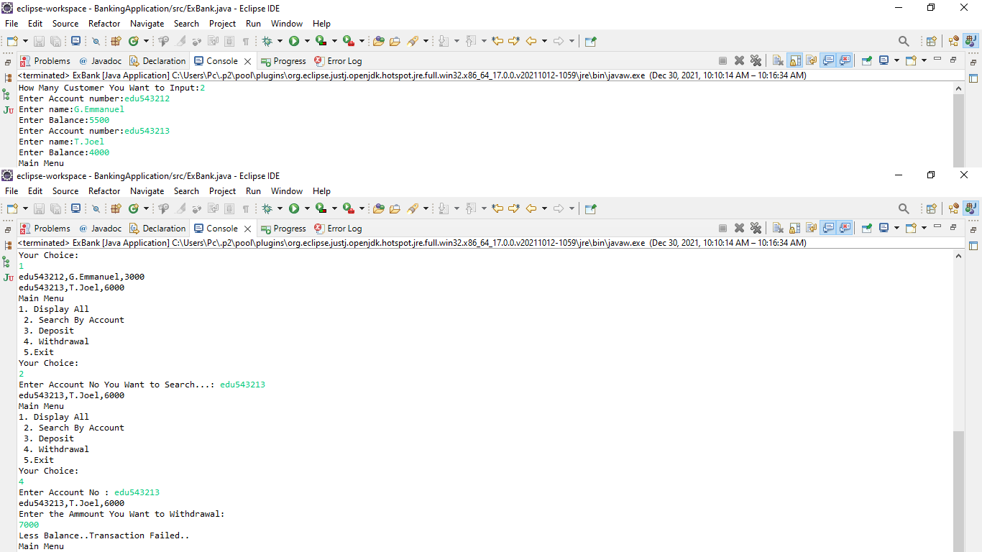
OUTPUT:

Slide 5
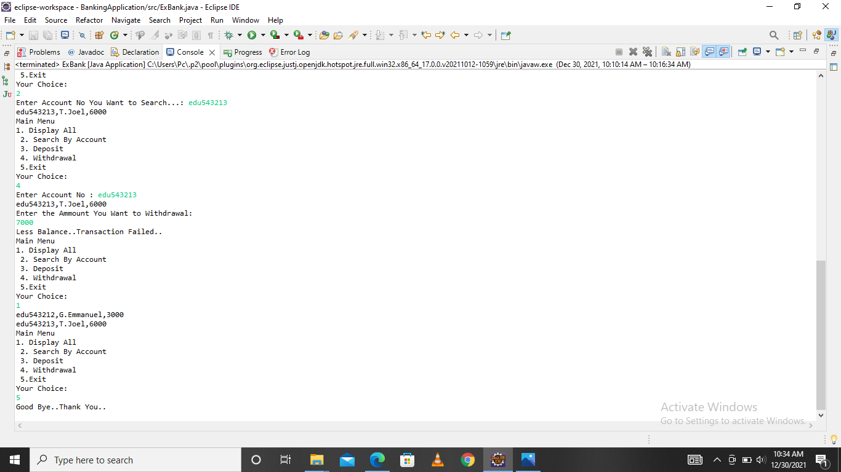

Slide 6
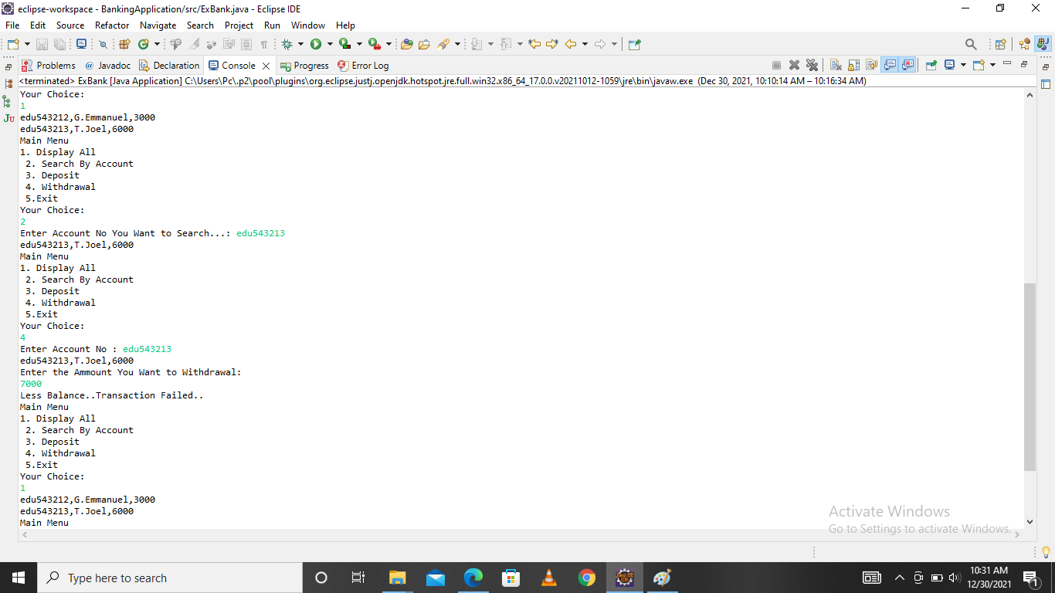

Slide 7


